Slide 1
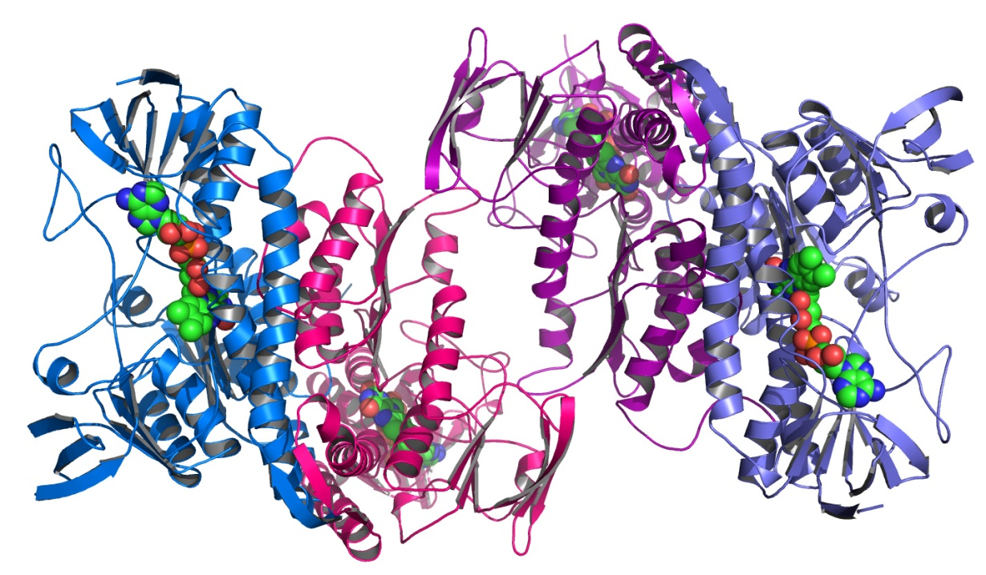

Chapter 3. Statistical Modelling: Understanding Mean Structure
Terry Neeman, PhD AStat
Statistical Consulting Unit (SCU)
John Dedman Building, ANU
Note: Prac requires packages ggplot2,
reshape2 and emmeans

Slide 2
Key components of a statistical model of an experiment
Outcome measure
Response variable
Measure of interest
Experimental factors
Conditions that can be manipulated
Conditions of interest (e.g. genotype, gender)
Main questions: do the conditions impact upon the outcome measure?
Blocking factors
Conditions (not of interest) that may impact upon the outcome measure
Sources of variation in the experiment that need to be controlled for
Clustering of experimental units
ALWAYS BEGIN WITH A RESEARCH QUESTION

Slide 3
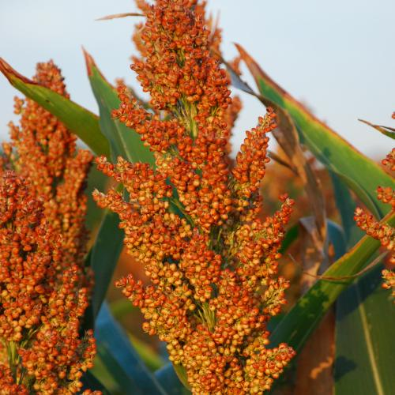
Example 1: Can drought tolerance in sorghum be improved through genetic modification?
Outcome measure
Leaf water retention LWR (%)
Experimental factors
Gene A (++/--)
Gene B (++/--)
4 parameter model
4 possible treatments |  | Gene A
 |  | ++ | --
Gene B | No | C | C+A
 | Yes | C+B | C+A+B+D

Slide 4
Spot the difference between the two models
Additive model- 3 parameter model
Expected Leaf Water Retention (%) under different experimental conditions
4 possible treatments |  | Gene A
 |  | ++ | --
Gene B | ++ | C | C+A
 | -- | C+B | C+A+B
Full factorial model – 4 parameter model
Expected Leaf Water Retention (%) under different experimental conditions
4 possible treatments |  | Gene A
 |  | ++ | --
Gene B | ++ | C | C+A
 | -- | C+B | C+A+B+D

Slide 5
Which model to use?
Depends upon your research question.
Experimental set-up:
10 plants per A/B genotype
Genotypes: AABB, aaBB, AAbb, aabb
Two factors, 2 levels/factor
Outcome measure: Leaf water retention(%)
Expected (average) response under different conditions
4 possible conditions |  | Gene A
 |  | AA | aa
Gene B | BB | c | (c+a)
 | bb | c+b | (c+a)+b+d

Slide 6
Data analysis
1. Organise data and import data
1 row per measure
Columns for sampleID/blocks
Columns for experimental factors
Column for measure
setwd(“ your dir here")
data2<- read.csv(“Prac 3 mock LWR.csv")
2. Visualise the data
ggplot(data2, aes(GeneB,LWR,colour=GeneA)) + geom_boxplot() + geom_point()
3. Model data
4. Assess model assumptions

Slide 7
Data analysis
1. Organise data and import data
2. Visualise the data
3. Model data and interpret output
library(emmeans)
lm1<-lm(LWR~GeneA*GeneB, data=data2)
anova(lm1)
summary(lm1)
emmeans(lm1,pairwise~GeneA|GeneB)
emmeans(lm1,pairwise~GeneB|GeneA)
4. Assess model assumptions
plot(lm1, which=1:2)

Slide 8
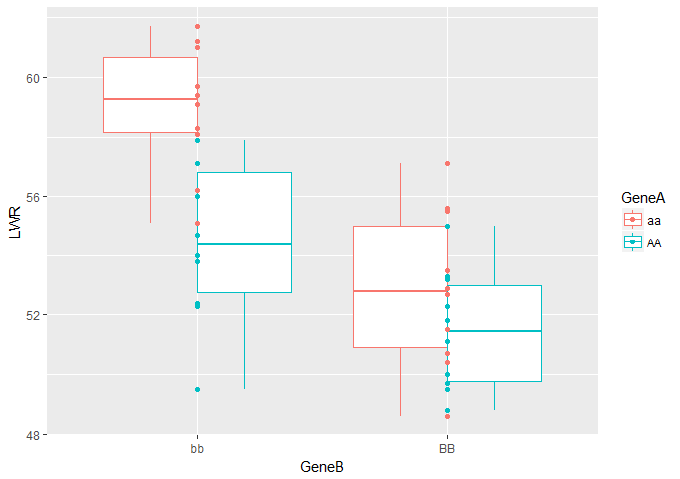
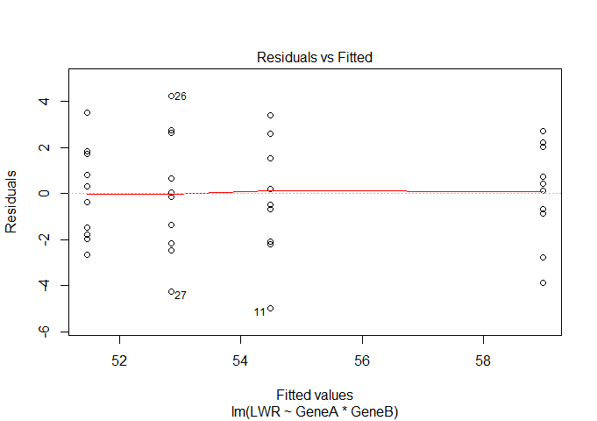
Model your data
Exploratory analysis
Assess model assumptions

Slide 9
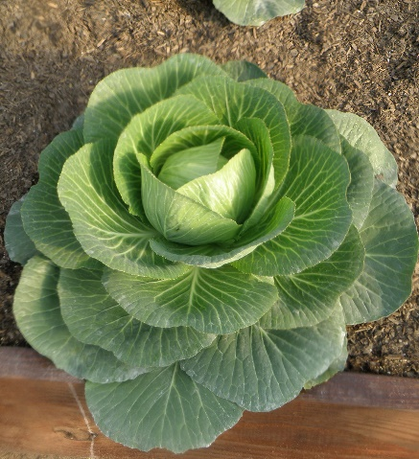

Which model to use?
Research question:
Which cabbage cultivar has the higher Vitamin C content on average?
Experimental set-up:
60 cabbage heads
2 cultivars: c39 and c52
3 planting dates: Days 16, 20, 21
Additive model assumes cultivar difference is same for each planting day
Average Vitamin C content |  | Cultivar
 |  | c39 | c52
Planting Date | Day 16 | A | A+B
 | Day 20 | A+C1 | A+C1+B
 | Day 21 | A+C2 | A+C2+B
 | MARGINAL MEANS
How many parameters in this model?

Slide 10
Data analysis
1. Import data
setwd(“your dir here")
cabbage<- read.csv(“Prac 3 cabbage.csv")
str(cabbage)
2. Visualise the data
ggplot(cabbage,aes(Date,VitC,colour=Cult))+
geom_boxplot()
3. Model data
lm2<-lm(VitC~Cult*Date, data=cabbage)
anova(lm2)
lm3<-lm(VitC~Cult+Date, data=cabbage)
anova(lm3)
emmeans(lm3,pairwise~Cult)
4. Assess model assumptions
plot(lm3, which=1:2)

Slide 11
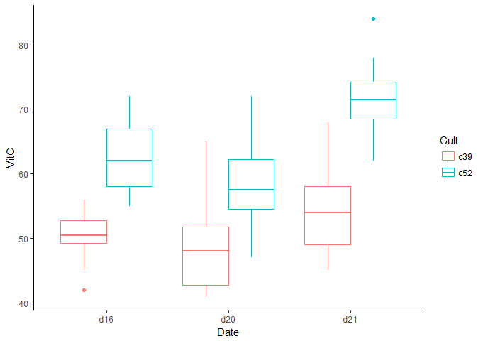
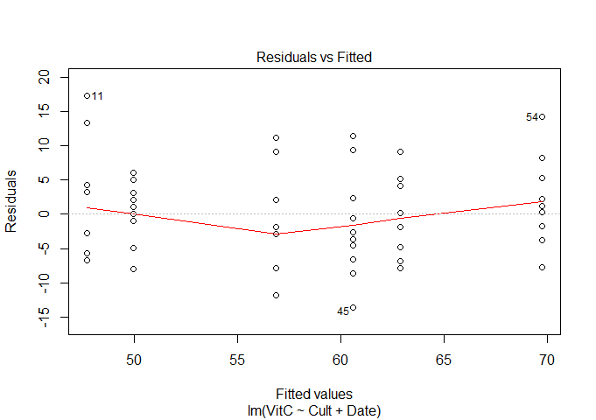

Model your data
Exploratory analysis
> lm2<-lm(VitC~Cult+Date, data=cabbage)
> anova(lm2)
Analysis of Variance Table
Response: VitC
Df Sum Sq Mean Sq F value Pr(>F)
Cult 1 2496.2 2496.15 53.0411 1.179e-09 ***
Date 2 909.3 454.65 9.6609 0.0002486 ***
Residuals 56 2635.4 47.06
> emmeans(lm2,pairwise~Cult)
$emmeans
Cult emmean SE df lower.CL upper.CL
c39 51.5 1.252474 56 48.99099 54.00901
c52 64.4 1.252474 56 61.89099 66.90901
Results are averaged over the levels of: Date
Confidence level used: 0.95
$contrasts
contrast estimate SE df t.ratio p.value
c39 - c52 -12.9 1.771265 56 -7.283 <.0001
Results are averaged over the levels of: Date
Assess model assumptions

Slide 12
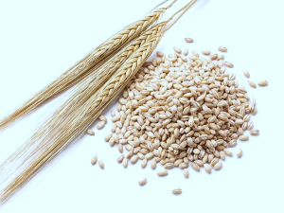
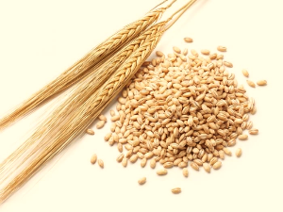
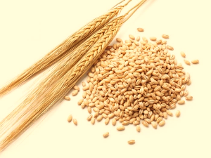
Which model to use?
Research question:
Compare yields of 5 varieties of barley
Experimental set-up:
60 plots
5 varieties: “M”, “P”, “S”, “T”, “V”
6 locations: “C”,”D”, “GR”, “M”, “UF”, “W”
2 crop years: 1930, 1931
Additive model assumes difference between varieties independent of location and Year.
Average Yield |  | Variety
 |  | M | P | S | T | V
Year | 1930
 | 1931
 | MARGINAL MEANS
How many parameters in this model?

Slide 13
Data analysis
1. Import data
setwd(“your dir here")
barley<- read.csv(“Prac 3 barley yield.csv")
str(barley)
2. Restructure data
barley2<- melt(barley, id.vars=c(“Loc”,”Var”),
value.var= , variable.var= ) #incomplete
str(barley)
3. Visualise the data
ggplot(barley2,aes(Var,Yield,colour=Year))+
geom_boxplot()
#how else can you visualise patterns
in the data?

Slide 14
Data analysis
1. Import data
2. Restructure data
3. Visualise data
4. Model data and interpret the output
lm4<-lm(Yield~Var+Loc, data=barley)
anova(lm4)
lm5<-lm(Yield~Var+Loc+Year, data=barley)
anova(lm5)
emmeans(lm5,pairwise~Var)
5. Assess model assumptions
plot(lm5, which=1:2)

Slide 15
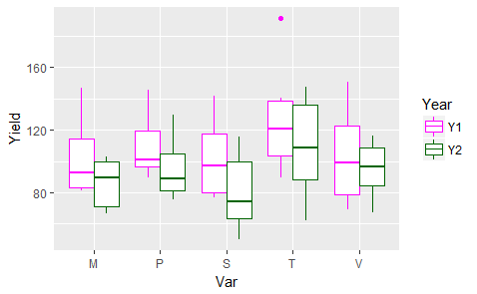
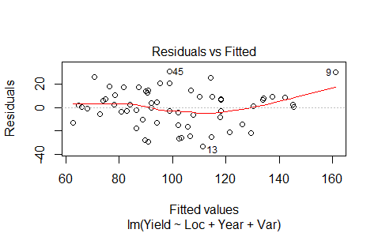
Model your data
Exploratory analysis
> lm5<-lm(Yield~Loc+Year +Var, data=barley2)
> anova(lm5)
Analysis of Variance Table
Response: Yield
Df Sum Sq Mean Sq F value Pr(>F)
Loc 5 21220.9 4244.2 14.4390 1.088e-08 ***
Year 1 3798.5 3798.5 12.9228 0.00075 ***
Var 4 5310.0 1327.5 4.5162 0.00347 **
Residuals 49 14403.0 293.9
> emmeans(lm5,pairwise~Var)
$emmeans
Var emmean SE df lower.CL upper.CL
M 94.39167 4.949226 49 84.44582 104.3375
P 102.54167 4.949226 49 92.59582 112.4875
S 91.13333 4.949226 49 81.18749 101.0792
T 118.20000 4.949226 49 108.25416 128.1458
V 99.18333 4.949226 49 89.23749 109.1292
Results are averaged over the levels of: Loc, Year
Confidence level used: 0.95
Assess model assumptions

Slide 16
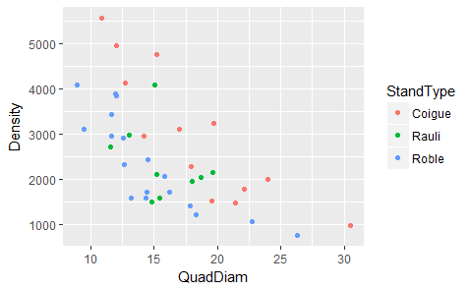
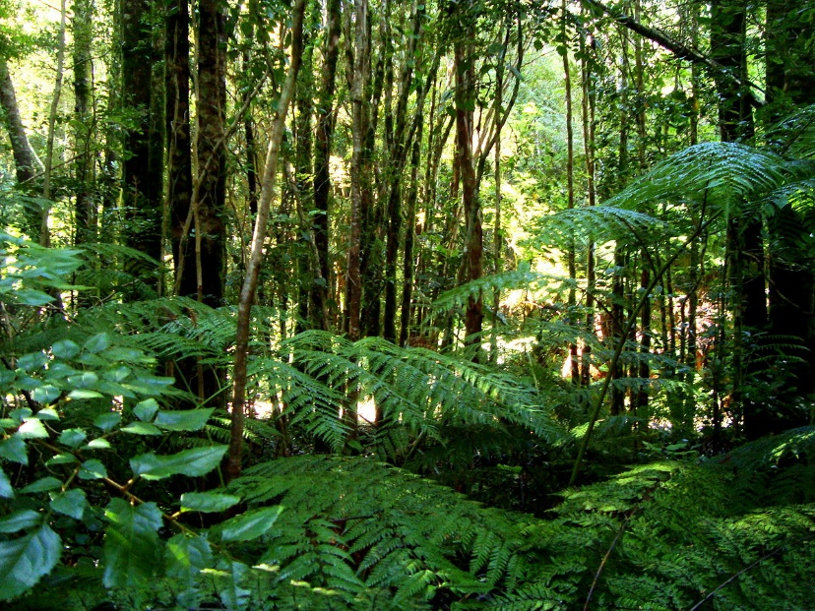
Which model to use?
Research question: What is the relationship between mean quadratic diameter and plot density in Nothofagus forest in the Andes? Does this relationship differ between tree species?
Experimental set-up:
41 plots
3 species (StandTypes)
Outcome measure: Plot Density
Factors: StandType, QuadDiam
Blocking factors: ?
Acknowledgements: Statistics in Biology, Welham et al
Notes:
Try also: ggplot(mice, aes(factor(Age), Wt, colour=treat))+geom_boxplot()

Slide 17
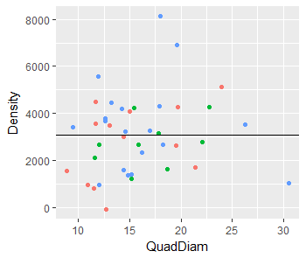
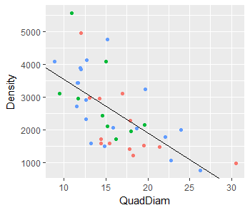
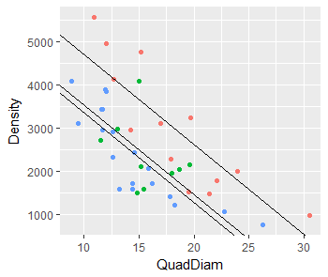
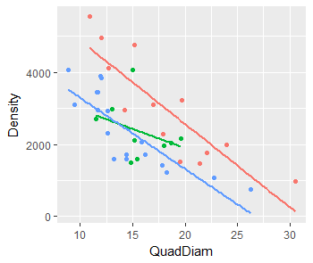
Which model to use?
Not QuadDiam, not Standtype
QuadDiam, not Stand Type
QuadDiam + Stand Type
Parallel lines
QuadDiam * Stand Type
Separate lines

Slide 18
Data analysis
1. Import data
setwd(“your dir here")
forest<- read.csv(“Prac 3 forest.csv")
str(forest)
View(forest)
2. Visualise the data
ggplot(forest,aes(Density,QuadDiam,colour=StandType))+
geom_boxplot()
#What patterns do you observe?

Slide 19
Data analysis
1. Import data
2. Restructure data
3. Visualise data
4. Model data and interpret the output
lm6<-lm(Density~QuadDiam*StandType, data=forest)
anova(lm6)
lm7<-lm(Density~QuadDiam+StandType, data=forest)
anova(lm7)
emmeans(lm7,pairwise~StandType)
5. Assess model assumptions
plot(lm7, which=1:2)

Slide 20
Model your data
Exploratory analysis
> lm6<-lm(Density~QuadDiam+StandType, data=forest)
> anova(lm6)
Analysis of Variance Table
Response: Density
Df Sum Sq Mean Sq F value Pr(>F)
QuadDiam 1 22596452 22596452 44.6125 9.949e-08 ***
StandType 2 13064564 6532282 12.8968 6.363e-05 ***
QuadDiam:StandType
2 809573 404787 0.7992 0.4577
Residuals 35 17727660 506505
> emmeans(lm6,pairwise~StandType)
NOTE: Results may be misleading due to involvement in interactions
$emmeans
StandType emmean SE df lower.CL upper.CL
Coigue 3504 214.8 35 3068 3940
Rauli 2322 238.5 35 1838 2806
Roble 2118 172.3 35 1768 2468
Assess model assumptions

